Slide 1
AZ-304: Microsoft Azure Architect Design

Slide 2
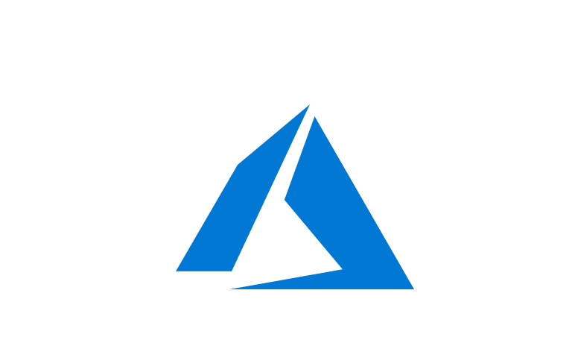
Course Outline
Module 1: Design a Compute Solution
Module 2: Design a Network Solution
Module 3: Design for Migration
Module 4: Design Authentication and Authorization
Module 5: Design Governance
Module 6: Design a Solution for Databases
Module 7: Select an Appropriate Storage Account
Module 8: Design Data Integration
Module 9: Design a Solution for Logging and Monitoring
Module 10: Design a Solution for Backup and Recovery
Module 11: Design for High Availability
Module 12: Design for Cost Optimization
Module 13: Design an Application Architecture
Module 14: Design Security for Applications
NOTE: The module order listed above aligns with the learning objectives described on the AZ-304: Microsoft Azure Architect Design certification page.

Slide 3
Module 10: Design a Solution for Backup and Recovery
Solutions for Azure Site Recovery, Data Archiving, and Retention

Slide 4
Learning Objectives
Architectural Best Practices for Reliability
Recommend an Azure Site Recovery Solution
Module Review Questions

Slide 5
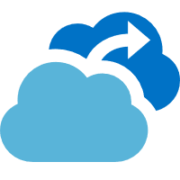
Architectural Best Practices for Reliability

Slide 6

Architectural Best Practices for Reliability
Define Requirements
Use Architectural Best Practices
Test with Simulations and Forced Failovers
Deploy the Application Consistently
Monitor Application Health
Respond to Failures and Disasters
See: Azure Well-Architected Framework
See: Overview of the reliability pillar
Notes:
This lesson describes six steps for building a reliable Azure application.
Define Requirements. Develop availability and recovery requirements based on decomposed workloads and business needs.
Use Architectural Best Practices. Follow proven practices, identify possible failure points in the architecture, and determine how the application will respond to failure.
Test with Simulations and Forced Failovers. Simulate faults, trigger forced failovers, and test detection and recovery from these failures.
Deploy the Application Consistently. Release to production using reliable and repeatable processes.
Monitor Application Health. Detect failures, monitor indicators of potential failures, and gauge the health of your applications.
Respond to Failures and Disasters. Identify when a failure occurs and determine how to address it based on established strategies.

Slide 7

Define Requirements
Identify workloads and usage
Plan for usage patterns
Establish availability metrics (MTTR/MTBF)
Establish recovery metrics (RTO/RPO)
Determine workload availability targets
Understand service-level agreements
See: Define requirements
Notes:
Identify workloads and usage. A workload is a distinct capability or task that is logically separated from other tasks, in terms of business logic and data storage requirements.
Plan for usage patterns. Identify differences in requirements during critical and non-critical periods.
Establish availability metrics — mean time to recovery (MTTR) and mean time between failures (MTBF). Use MTTR and MTBF to determine where to add redundancy and to determine service-level agreements (SLAs) for customers.
Establish recovery metrics — recovery time objective and recovery point objective (RPO). Conduct a risk assessment to determine the cost and risk of downtime or data loss using RTO/RPO baselines.
Determine workload availability targets. Determine target SLAs for each application workload and account for the cost and complexity.
Understand service-level agreements.

Slide 8

Use Architectural Best Practices
Perform a failure mode analysis (FMA)
Create a redundancy plan
Design for scalability
Plan for subscription and service requirements
Use load-balancing to distribute requests
Build availability requirements into your design
Manage your data
See: Use architectural best practices
Notes:
Perform a failure mode analysis (FMA). FMA builds resiliency into an application early in the design stage.
Create a redundancy plan. The level of redundancy required for each workload depends on your business needs and factors into the overall cost of your application.
Design for scalability. A cloud application must be able to scale to accommodate changes in usage.
Plan for subscription and service requirements. You might need additional subscriptions to provision enough resources to meet your business requirements for storage, connections, throughput, and more.
Use load-balancing to distribute requests. Load-balancing distributes your application's requests to healthy service instances by removing unhealthy instances from rotation.
Build availability requirements into your design. Availability is the proportion of time your system is functional and working. Take steps to ensure that application availability conforms to your service-level agreement
Manage your data. How you store, back up, and replicate data is critical.

Slide 9

Azure Service Dependencies
There are no services that are dependent on a single logical data center
Non-regional services are deployed to two or more regions
Customer specific regions in which their data will be stored
Azure service dependency documentation
See: Azure service dependencies
Notes:
There are no services that are dependent on a single logical data center
Non-regional services are deployed to two or more regions and if there is a regional failure, the instance of the service in another region continues servicing customers.
All Azure services that store customer data allow the customer to specify the specific regions in which their data will be stored.
If you need to understand dependencies between Azure services to help better architect your applications and services, you can request the Azure service dependency documentation by contacting your Microsoft sales or customer representative. This document lists the dependencies for Azure services, including dependencies on any common major internal services such as control plane services.

Slide 10
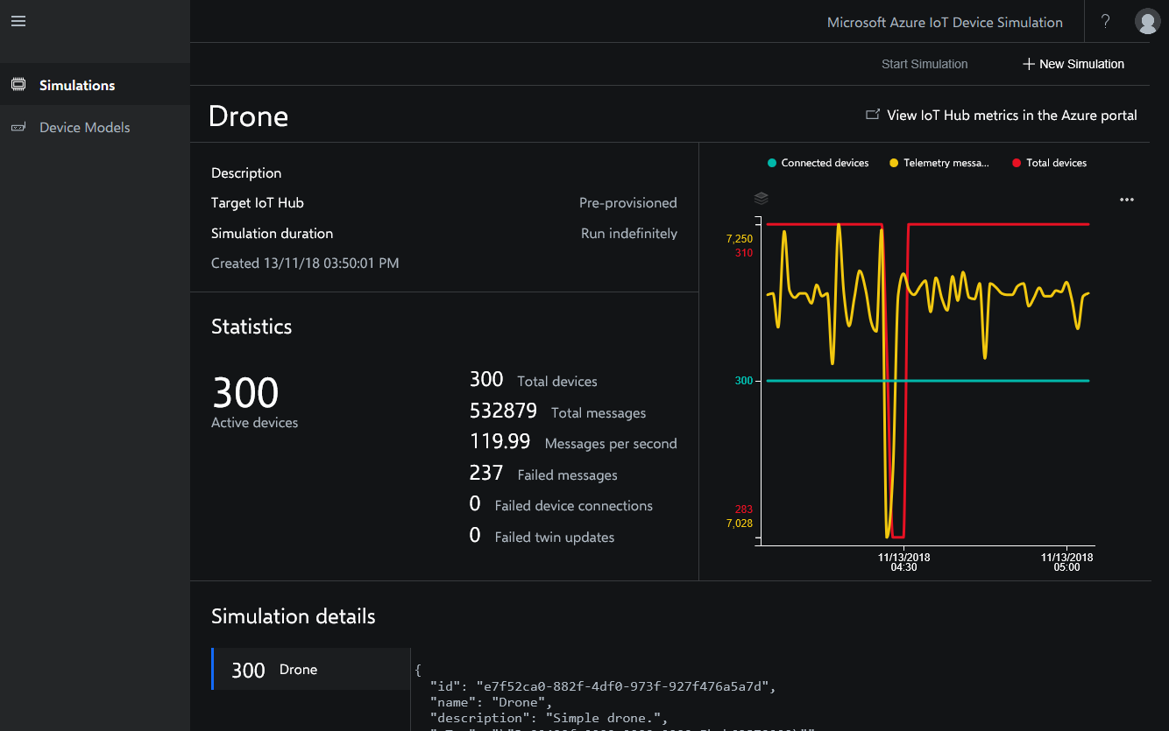
Test with Simulations and Forced Failovers
Test for common failure scenarios by triggering actual failures or by simulating them
Identify failures that occur only under load
Run disaster recovery drills
Perform failover and failback testing
Run simulation tests
Test health probes
Test monitoring systems
Include third-party services in test scenarios
See: Test with simulations and forced failovers
Notes:
Test for common failure scenarios by triggering actual failures or by simulating them. Use fault injection testing to test common scenarios and recovery time.
Identify failures that occur only under load. Test for peak load, using production data or synthetic data that is as close to production data as possible.
Run disaster recovery drills. Have a disaster recovery plan in place and test it periodically.
Perform failover and failback testing.
Run simulation tests. Testing real-life scenarios can highlight issues that need to be addressed.
Test health probes. Configure health probes for load balancers and traffic managers to check critical system components.
Test monitoring systems. Be sure that monitoring systems are reliably reporting critical information and accurate data.
Include third-party services in test scenarios. Test possible points of failure due to third-party service disruption, in addition to recovery.

Slide 11

Deploy Applications Consistently
Automate your application deployment process
Design your release process to maximize availability
Have a rollback plan for deployment
Log and audit deployments
Document the application release process
See: Deploy the application consistently
Notes:
Automate your application deployment process. Automate as many processes as possible.
Design your release process to maximize availability. If your release process requires services to go offline during deployment, your application is unavailable until they come back online.
Have a rollback plan for deployment. Design a rollback process to return to a last known good version and to minimize downtime if a deployment fails.
Log and audit deployments. If you use staged deployment techniques, more than one version of your application is running in production.
Document the application release process. Clearly define and document your release process and ensure that it's available to the entire operations team.

Slide 12
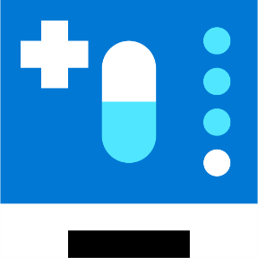
Monitor Application Health
Implement health probes and check functions
Check long-running workflows
Maintain application logs
Measure remote call statistics and share the data with the application team
Track transient exceptions and retries over an appropriate time frame
Set up an early warning system
Operate within Azure subscription limits
Monitor third-party services
Train multiple operators to monitor the application and to perform manual recovery steps
See: Monitor application health

Slide 13
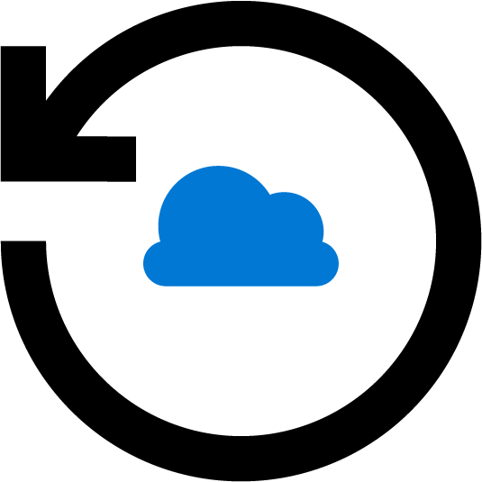
Respond to Failures and Disasters
Plan for Azure support interactions
Document and test your disaster recovery plan
Fail over manually when required
Prepare for application failure
Recover from data corruption
Recover from a network outage
Recover from a dependent service failure
Recover from a region-wide service disruption
See: Respond to failures and disasters

Slide 14
Recommend an Azure Site Recovery Solution

Slide 15
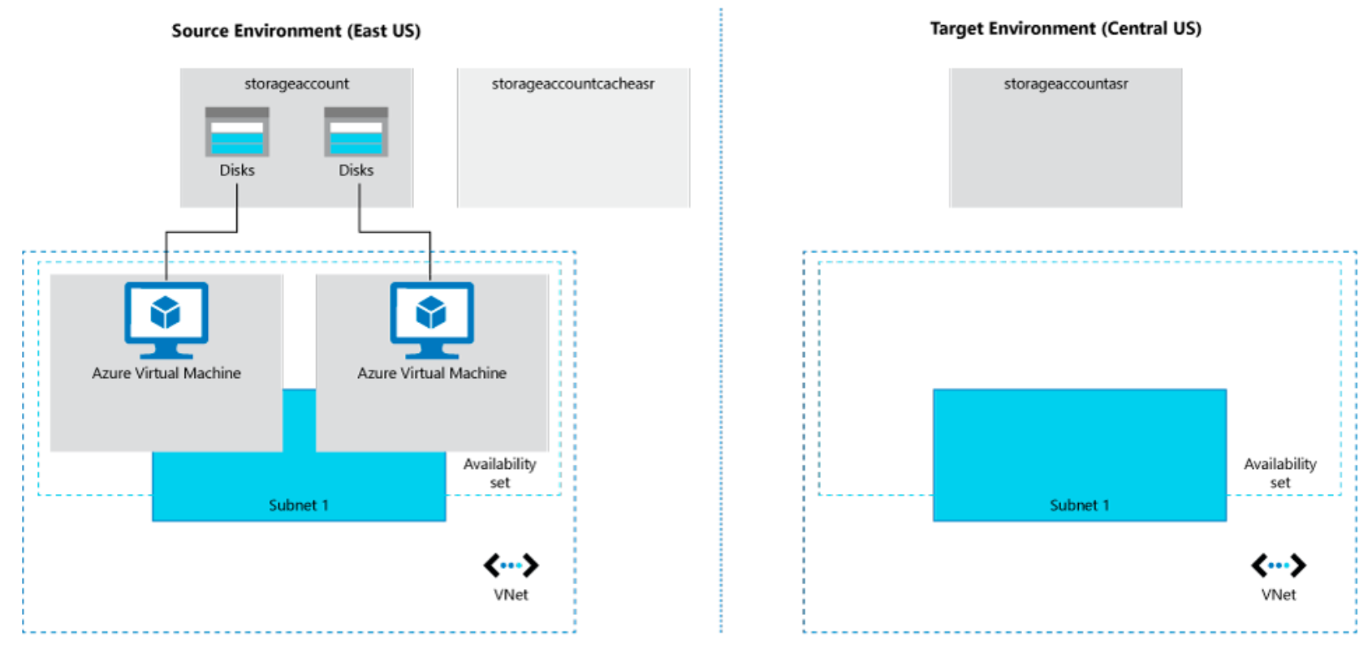
Azure to Azure Disaster Recovery Architecture
Notes:
VMs in source region
One of more Azure VMs in a supported source region.
Source VM storage
Azure VMs can be managed, or have non-managed disks spread across storage accounts.
Source VM networks
VMs can be in one or more subnets in a virtual network (VNet) in the source region.
Cache storage account
You need a cache storage account in the source network.
Target resources
Target resources are used during replication, and when a failover occurs.

Slide 16
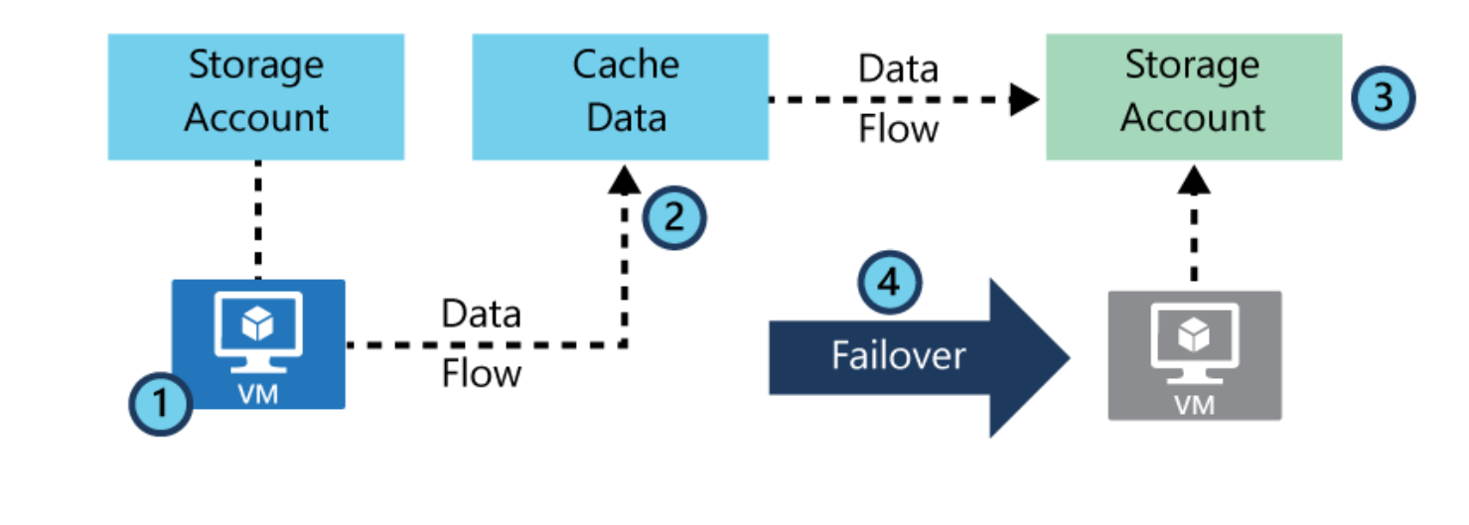
Target Resources
Subscription
Resource group
VNet
Storage account
Managed disks
Availability sets
Availability zones

Slide 17
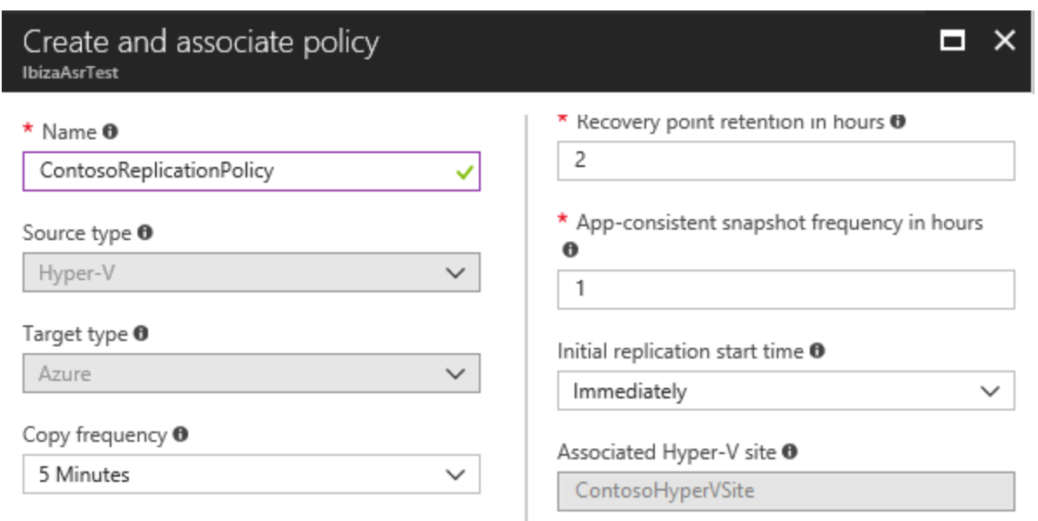
Replication Policy
Recovery Point Retention
App-Consistent Snapshot Frequency
See: Replication policy
Notes:
You can manage and modify the default replication policies settings as follows:
You can modify the settings as you enable replication.
You can create a replication policy at any time, and then apply it when you enable replication.

Slide 18

Snapshots and Recovery Points
Recovery points are created from snapshots
Site Recovery snapshots:
Crash-consistent - data that was on the disk when the snapshot was taken
App-consistent - all the information in a crash-consistent snapshot, plus all the data in memory and transactions in progress
See: Snapshots and recovery points
Notes:
Recovery points are created from snapshots of VM disks taken at a specific point in time. When a VM fails over, you use a recovery point to restore the VM in the target location.
When failing over, we generally want to ensure that the VM starts with no corruption or data loss, and that the VM data is consistent for the operating system, and for apps that run on the VM. This depends on the type of snapshots taken.
Site Recovery takes snapshots as follows:
Site Recovery takes crash-consistent snapshots of data by default, and app-consistent snapshots if you specify a frequency for them.
Recovery points are created from the snapshots and stored in accordance with retention settings in the replication policy.

Slide 19
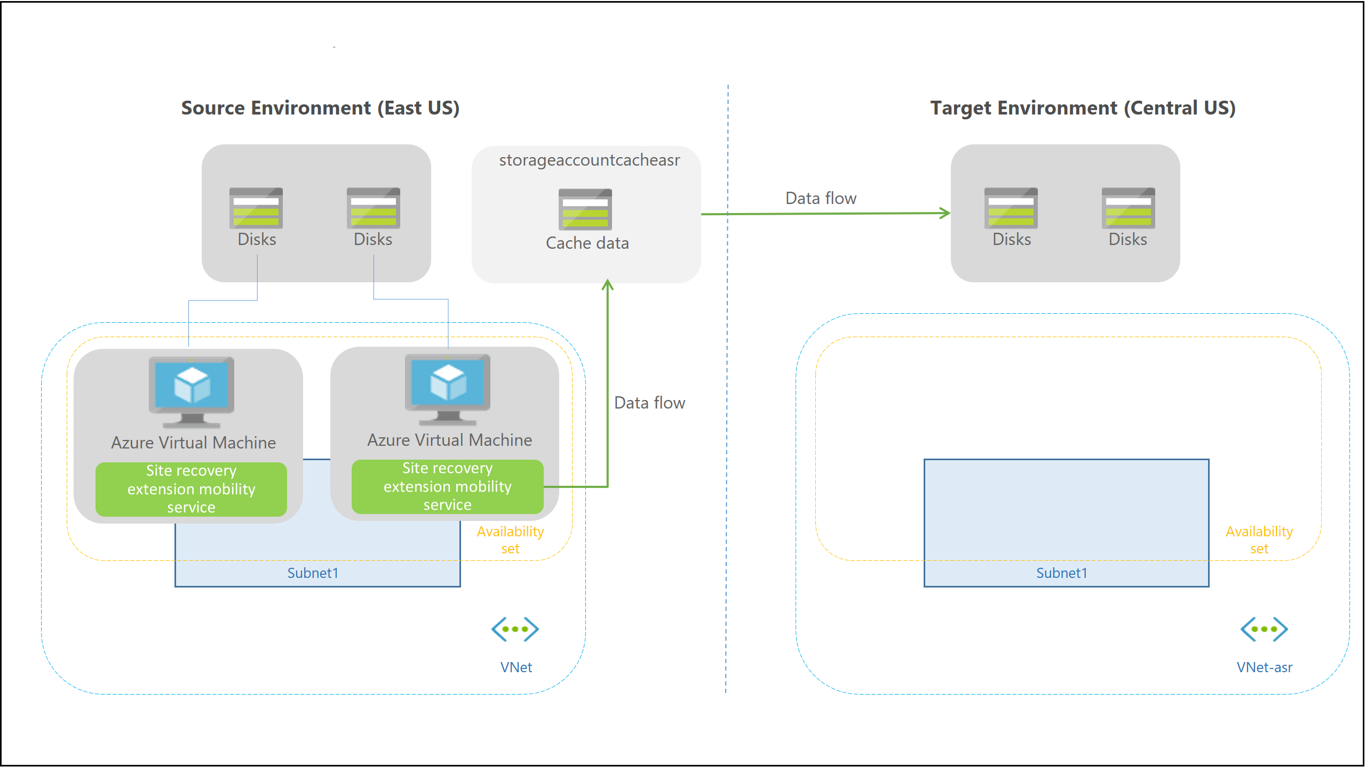
Replication Process
When replication is enabled for an Azure VM:
Extension installed on VM
Extension registers the VM with Site Recovery
Continuous replication begins
Disk writes are transferred to cached storage
Data is processed and sent to target storage account or replicated disk
After processing - crash-consistent recovery points are generated every five minutes
Notes:
When replication is enabled for an Azure VM:
The Site Recovery Mobility service extension is automatically installed on the VM.
The extension registers the VM with Site Recovery.
Continuous replication begins for the VM. Disk writes are immediately transferred to the cache storage account in the source location.
Site Recovery processes the data in the cache, and sends it to the target storage account, or to the replica managed disks.
After the data is processed, crash-consistent recovery points are generated every five minutes.

Slide 20
Connectivity Requirements
Outbound connectivity (URLs)
See: Outbound connectivity (URLs)
URL | Details
*.blob.core.windows.net | Allows data to be written from the VM to the cache storage account in the source region.
login.microsoftonline | Provides authorization and authentication to Site Recovery service URLs.
*.hypervrecoverymanager.windowsazure.com | Allows the VM to communicate with the Site Recovery service.
*.servicebus.windows.net | Allows the VM to write Site Recovery monitoring and diagnostics data.
*.vault.azure.net | Allows access to enable replication for ADE-enabled virtual machines via portal
*.automation.ext.azure.com | Allows enabling auto-upgrade of mobility agent for a replicated item via portal
Source region rules
Rule | Details
Allow HTTPS outbound: port 443 | Allow ranges that correspond to storage accounts in the source region
Allow HTTPS outbound: port 443 | Allow ranges that correspond to Azure Active Directory (Azure AD)
Allow HTTPS outbound: port 443 | Allow ranges that correspond to Events Hub in the target region.
Allow HTTPS outbound: port 443 | Allow ranges that correspond to Azure Site Recovery
Allow HTTPS outbound: port 443 | Allow ranges that correspond to Azure Key Vault (This is required only for enabling replication of ADE-enabled virtual machines via portal)
Allow HTTPS outbound: port 443 | Allow ranges that correspond to Azure Automation Controller (This is required only for enabling auto-upgrade of mobility agent for a replicated item via portal)

Slide 21
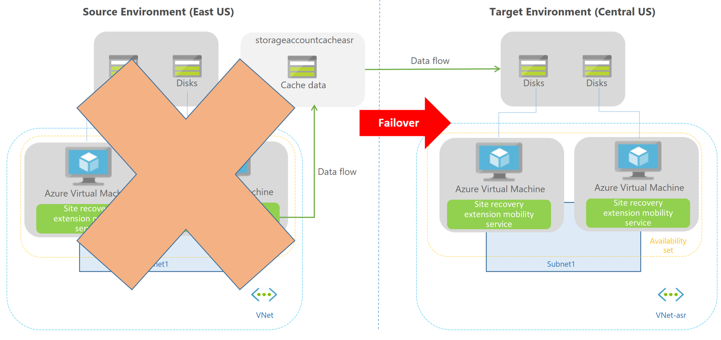
Failover Process
When a failover is initiated, the VMs are created in the target resource group, target virtual network, target subnet, and in the target availability set.
During a failover, you can use any recovery point.

Slide 22
Design a Solution for Data Archiving and Retention

Slide 23
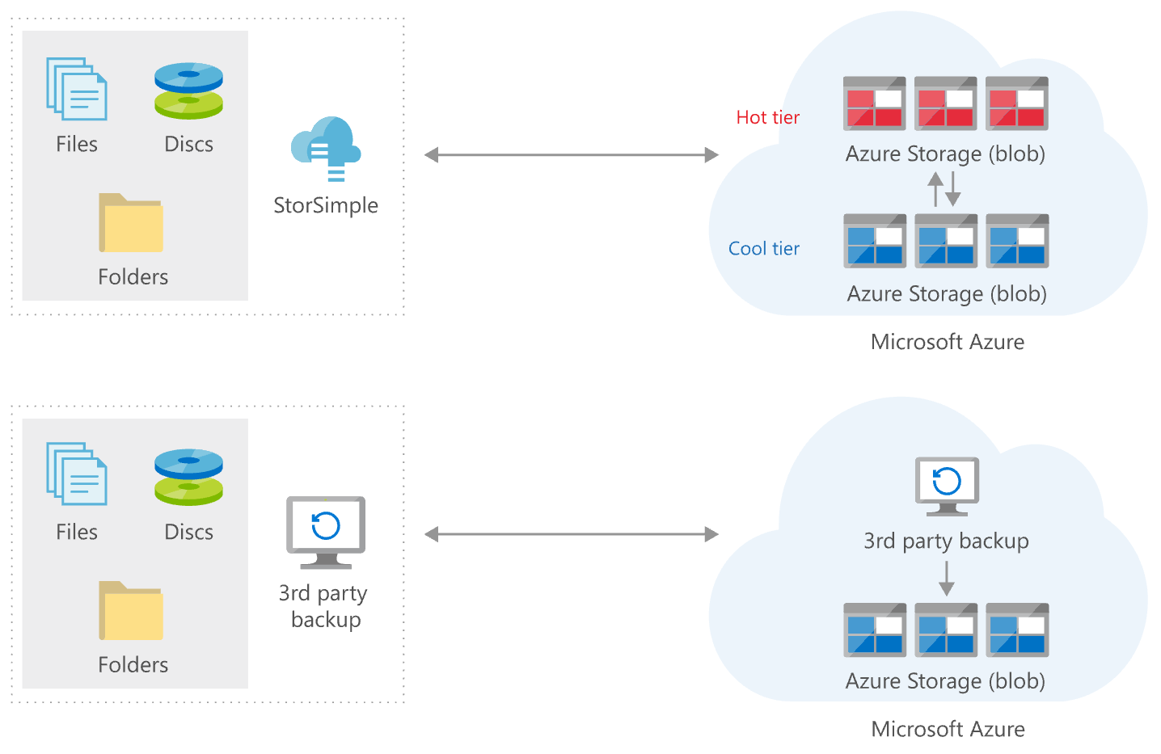
Archive On-Premises Data to Cloud
Archive on-premises data to Azure Blob storage
Azure StorSimple
Azure Blob Storage
Notes:
Azure StorSimple appliance running on-premises that can tier data to Azure Blob storage (both hot and cool tier). StorSimple can be used to archive data from on-premises to Azure.
Blob Storage: A cool or archive tier on Azure Blob storage is used to back up data that's less frequently accessed, while a hot tier is used to store data that's frequently accessed
https://azure.microsoft.com/en-in/solutions/architecture/backup-archive-on-premises/

Slide 24
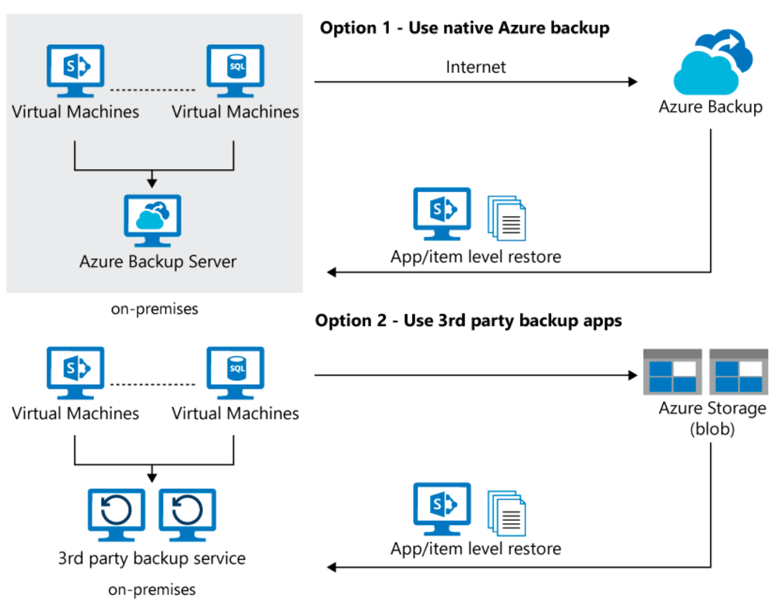
Backup On-Premises Applications and Data to the Cloud
Backup data and applications from an on-premises system to Azure using Azure Backup
Azure Backup Server
Azure Backup service
Blob Storage
Notes:
Azure Backup Server orchestrates the backup of machines and manages the configuration of the restore procedures.
Azure Backup service runs on the cloud and holds the recovery points, enforces policies, and enables you to manage data and application protection.
Blob Storage: Blob storage that partner solutions such as Commvault connect to for backing up data and applications. You need to create and manage Azure Blob storage when using partner solutions.
https://azure.microsoft.com/en-in/solutions/architecture/backup-archive-on-premises-applications/

Slide 25
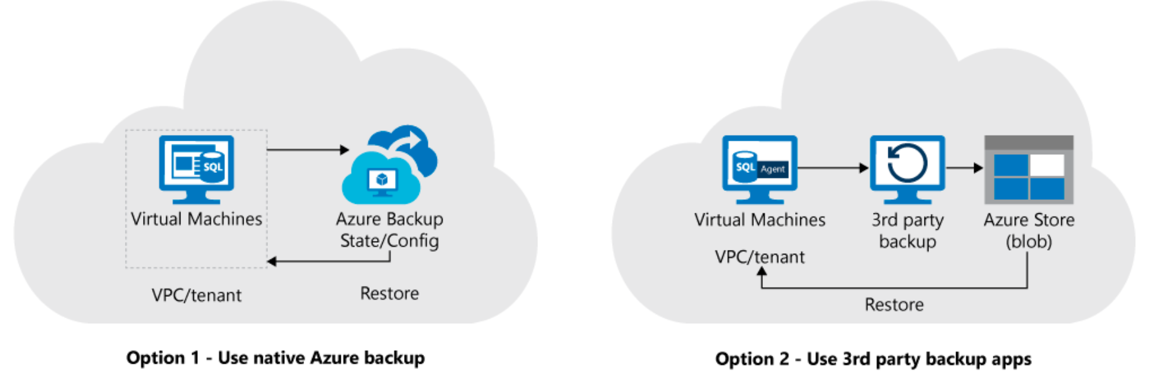
Backup Cloud Applications and Data to Cloud
Azure Backup
Blob Storage
Notes:
Azure Backup service runs on the cloud and holds the recovery points, enforces policies, and enables you to manage data and application protection. You don't need to create or manage an Azure Blob storage account when using Azure Backup.
Blob Storage: Blob storage that partner solutions such as Commvault connect to for backing up data and applications. You need to create and manage Azure Blob storage when using partner solutions
https://azure.microsoft.com/en-in/solutions/architecture/backup-archive-cloud-application/

Slide 26

Module 10 Review Questions

Slide 27
Online Role-based training resources: Microsoft Learn https://docs.microsoft.com/en-us/learn/

Slide 28
Thank you.

